Slide 1


DIGITAL BOOKS
PROJECT BY :
SRIJANI BM

Slide 2
Introduction Connecting all of us with the world of "BOOKS"
Here you can find wide range of books to gain knowledge in the varies platforms.
All the books will be available in fingertips.
One can buy the book and read it for the later interests.
Need not to carry the physical books anymore.
Buy anywhere, read everywhere.
Save the environment in all the means.

Slide 3


Author
Reader
Guest
Main roles played :

Slide 4
Author
Author able to signup to the site with some of the common details like Name, Email Id and Phone number.
Once signed up successfully one can able to login to the site.
Once logged in, has access to add the book and to write the book.
Author can update the content of the book after he\she added.
Author able to block and unblock his\her book so that book anymore available to the readers to access.

Slide 5
Reader
Reader can also register to the site with some of the common details like Email Id and Phone number.
Once signed up successfully one can able to login to the site.
Once logged in ,one can has access to search the books based on Category, based on the Author and Publisher of the book.
If the book got decided, one can buy the book by entering his\her email id.
Upon successful payment one can read the content of the book and view the invoice for book purchase.

Slide 6
Guest
No sign up and login for the guest user.
One can access the books page where he\she can search for the books based on Author Name ,Price and Category.
Once he gets the result, he\she can perform payment by entering his\her email id.
Upon successful payment one can read the content of the book and view the invoice for book purchased.

Slide 7
Asp .Net core Web Api’s
Angular
SQL
Technical Requirements:

Slide 8
Visual Studio 2022
Visual Studio Code
SQL server Management Studio
RabbitmQ
Azure
Software Requirements :

Slide 9
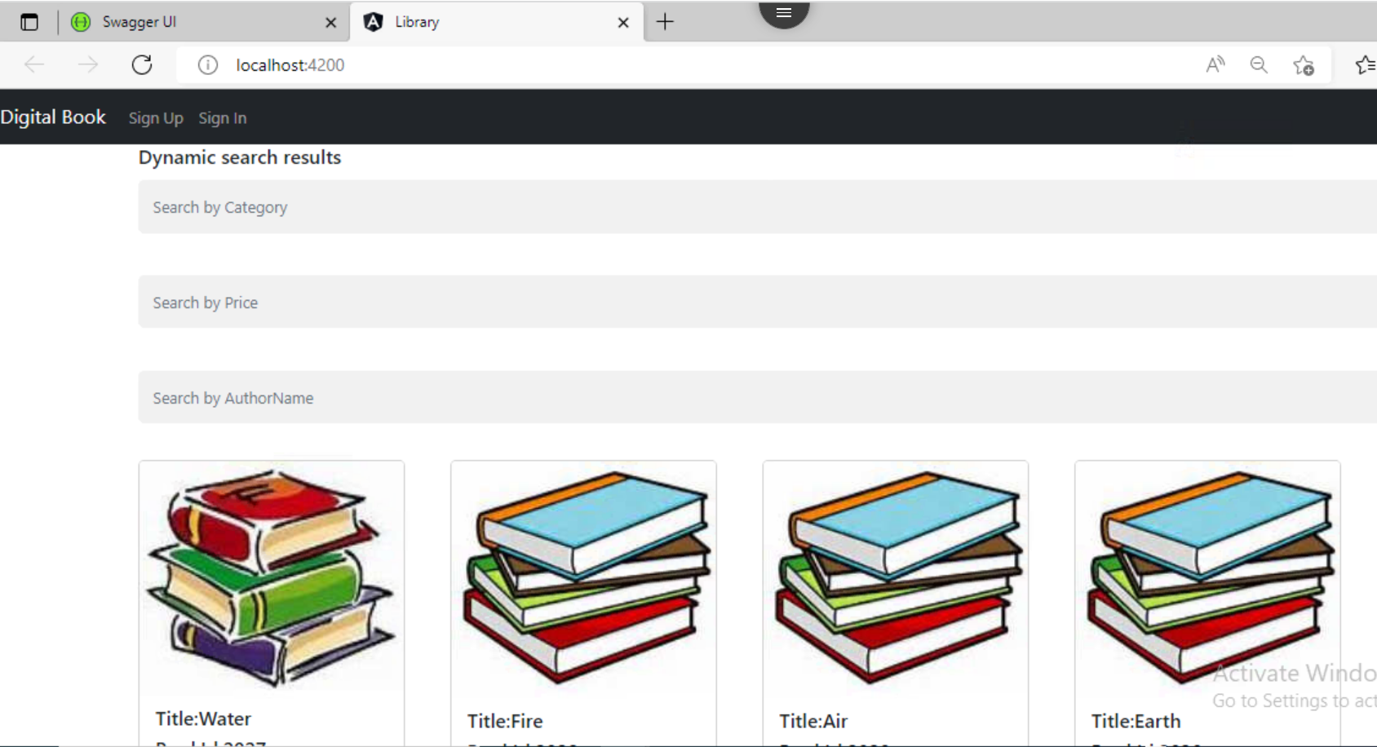
Home page:

Slide 10
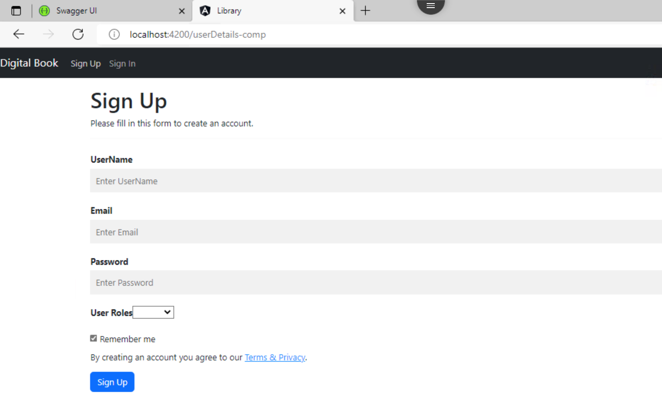
Sign Up page :

Slide 11
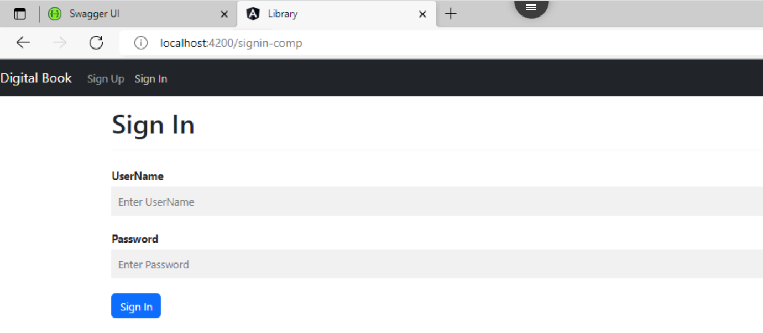
Sign In page:

Slide 12
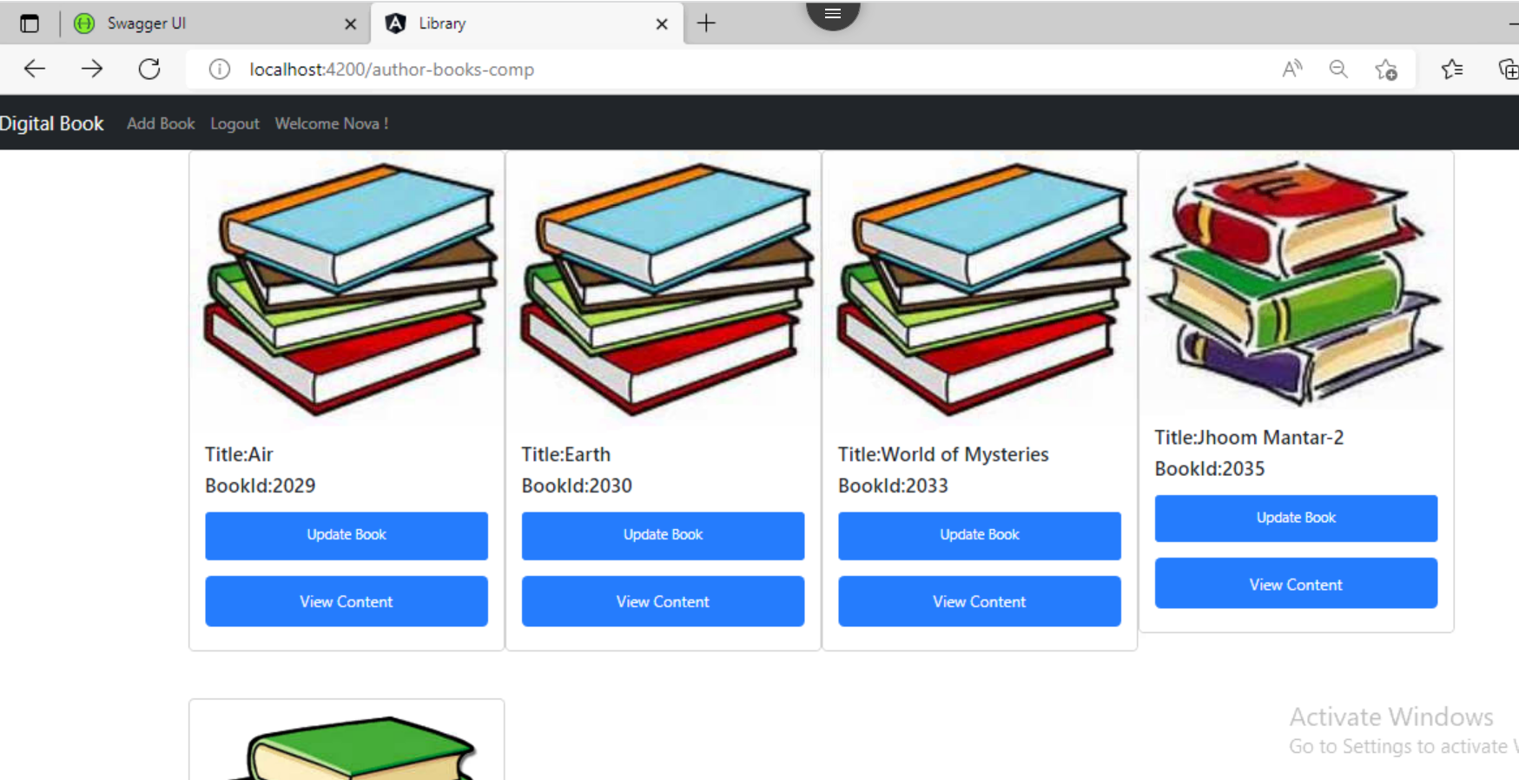
Author Books page :

Slide 13
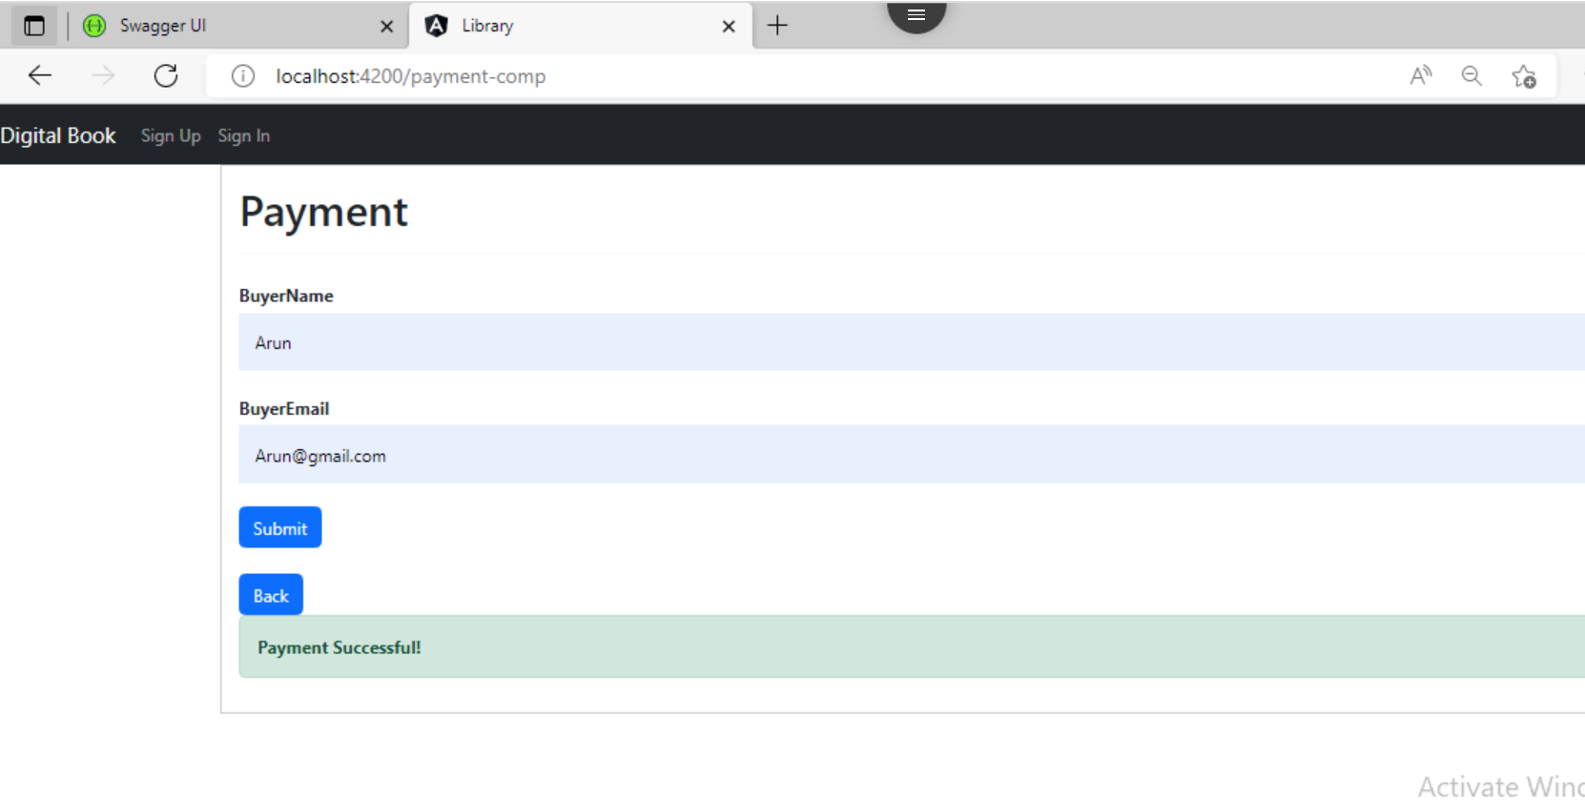
Payment page :

Slide 14
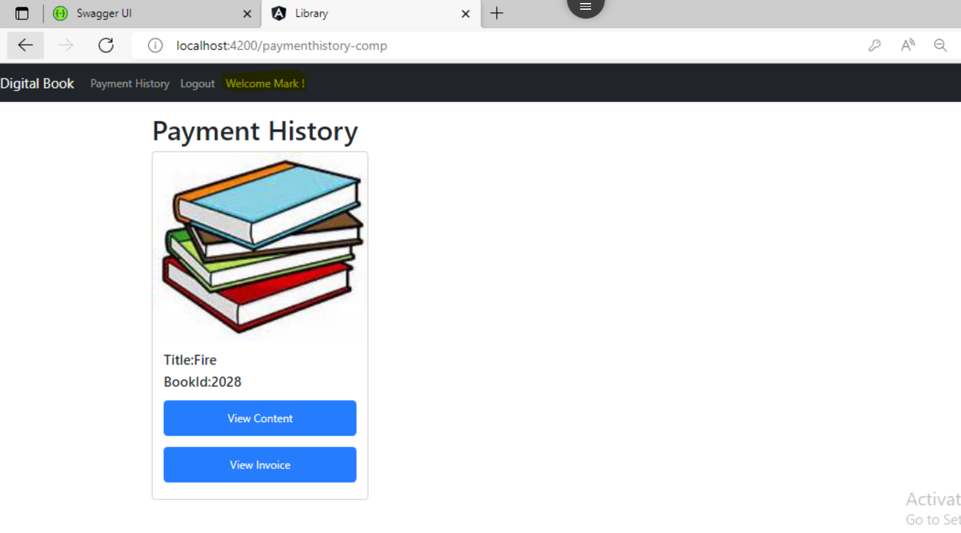
Payment history page:

Slide 15
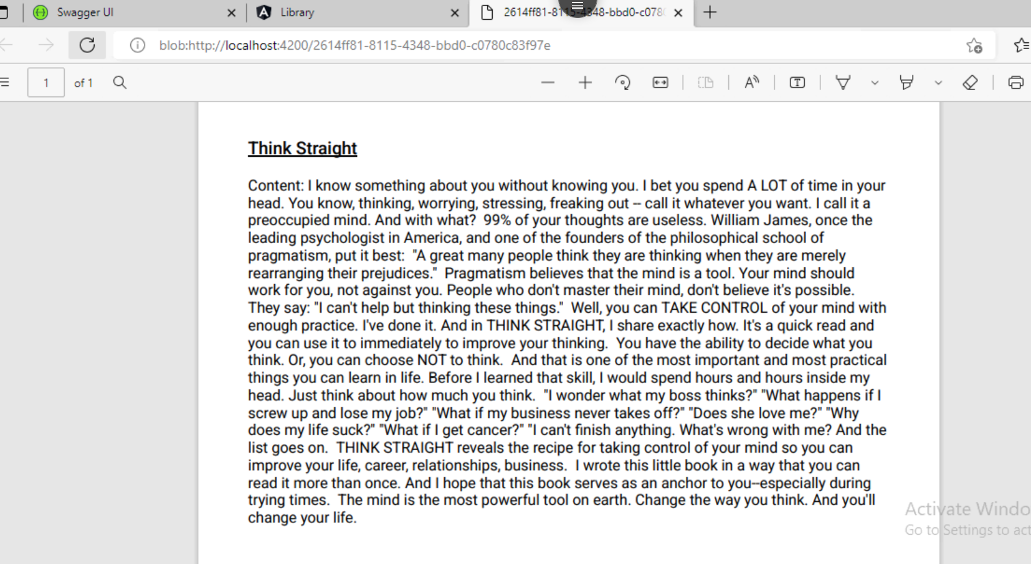
Book content view page:

Slide 16
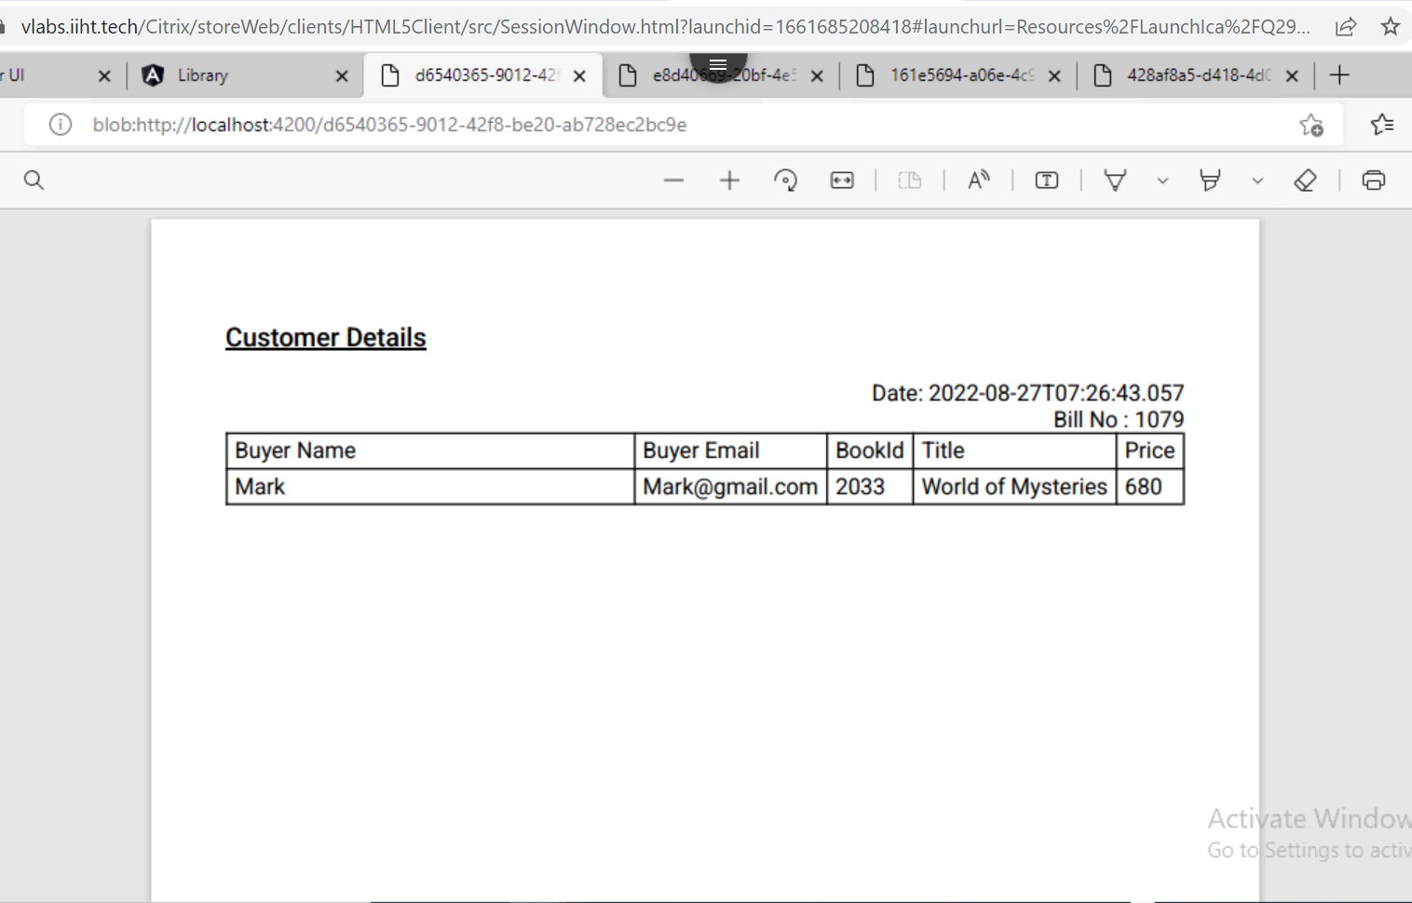
Invoice page:

Slide 17
Ready to buy!!!?
------------------------------------------Let’s close the deal today!!!!!!!!!!!!!!!!!!!!!!☺
THANK YOU ☺
Any ?????s

